Slide 1
Redox conditions and pH control trace element concentrations in a meandering stream and shallow groundwater of a semiarid mountain watershed, Red Canyon, Wyoming, USA
By Nicholas chan

Slide 2
Point of the Study
Searched for variability in redox conditions and trace element concentrations
Wanted a better understanding of oxic surface water and anoxic groundwater’s role in trace element cycling in mountain streams
To collect water isotope values
Notes:
Red Canyon is semiarid

Slide 3
Background Information
Biogeochemical cycling occurs in the redox boundary between surface water & groundwater
Chemical redox and pH affect groundwater composition
Transitions between the boundary can cause trace elements to move or stop
More needs to be understood about redox conditions influencing trace element cycling
Evaluation of seasonal variabilities will be done

Slide 4
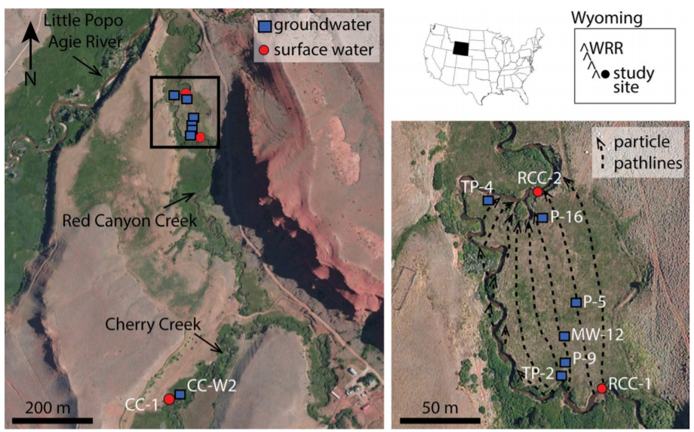
Sampling Locations
Taken at Cherry Creek and Red Canyon Creek
Particle path lines of groundwater
MODFLOW and MT3D model to show experimental reach at the canyon
Sedimentary beds underneath
Takes several years for water to travel through
Notes:
-samples taken from meandering sections of each creek

Slide 5
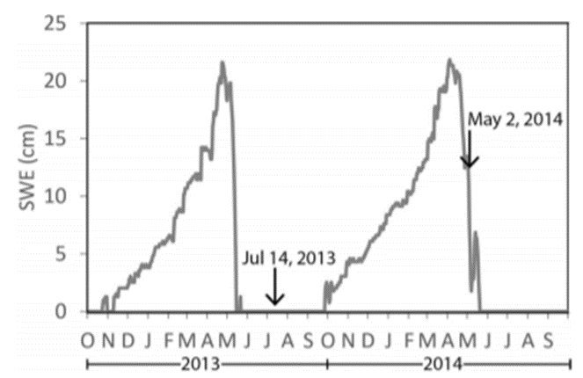
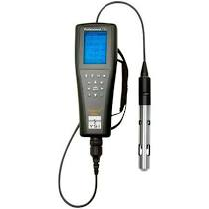
Sampling Procedure
Samples taken from Red Canyon, Wyoming during two different periods
Surface water and shallow groundwater were pumped
Different values were recorded by using a YSI Quatro multiparameter probe
Filtered samples to examine trace element conc. and major cations
One blank to track any possible errors

Slide 6
Analysis
ICP-MS used to measure concentrations of 40 elements
Collision cell for Al, Ca, Cr, Fe, K, Mn, Na, and V (4mL He/min)
Same for As and Se (4mL He/min + 2.5mL H₂/min)
Ar gas for other 30 elements
Water samples were compared with USGS and NIST standard reference samples for calibration verification
Results were accurate within 10% for most of the elements
Notes:
Solution was created to establish a calibration curve

Slide 7
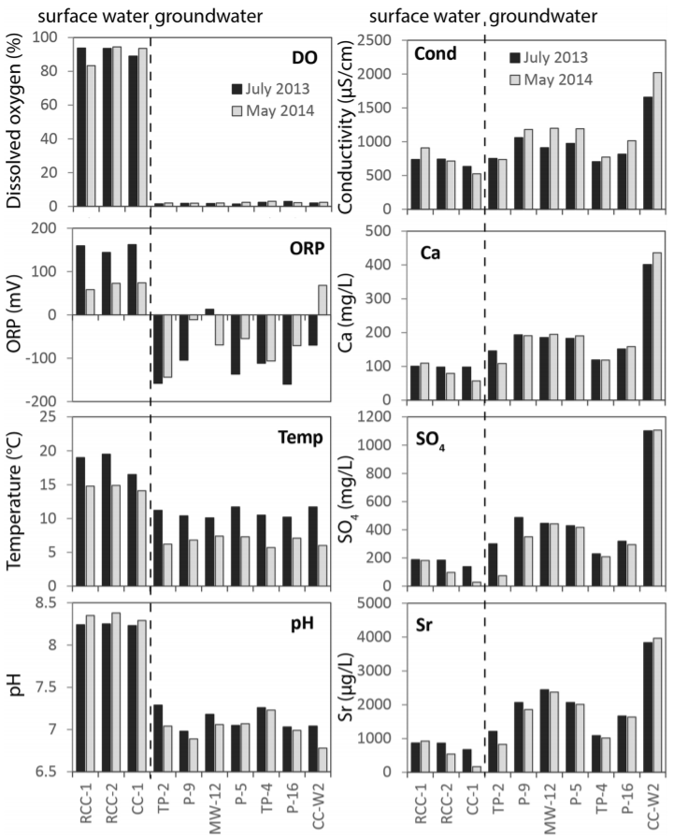
Results
Isotopes in water had very little seasonal variability in surface/groundwater (δD and δ¹⁸O)
Groundwater had more variability compared to surface water
Dissolved oxygen, water temp, ORP, and pH were higher in surface water
Positive ORP values in surface water, negative values in groundwater
Higher temp in surface waters, pH was greater than 8 in both
Major solute conc./conductivity were 50% higher in groundwater
Notes:
-delta deuterium was decreased in May and less than July
-Dissolved oxygen was>80% of saturation in surface water
-exception: in two wells there were slightly positive ORP values

Slide 8
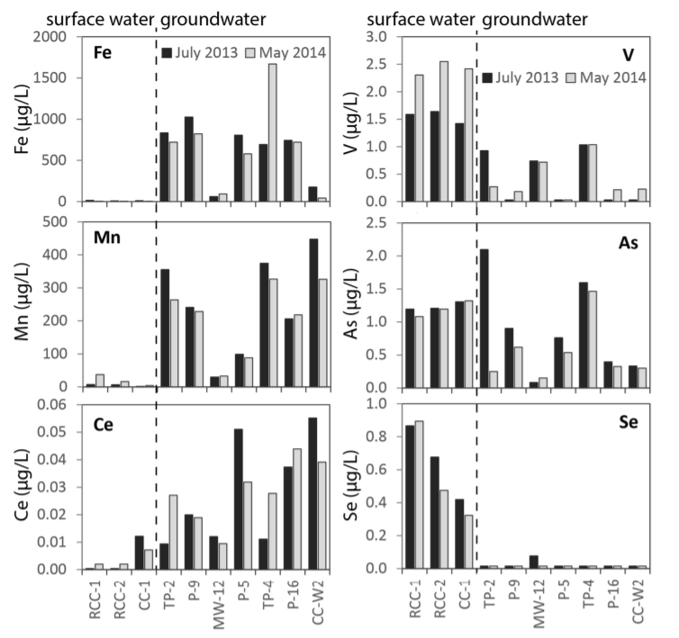
Results Continued
Cerium (7x), Fe (90x), and Mn (20x) conc. were higher in groundwater
As, Se (30x), and V (5x) conc. were greater in surface water
Surface water was oversaturated with carbonate minerals and Fe/Mn oxides
Groundwater was undersaturated or at equilibrium
Groundwater was oversaturated with Se

Slide 9
Water Chemistry Conclusions
Redox and pH play important roles in surface water and groundwater chemistry
Reductive dissolution of Mn & Fe oxides from the aquifer = higher conc. of both in groundwater
Groundwater oxidation during water exchange oversaturates surface water with Mn and Fe minerals
Cerium conc. In groundwater is higher due to solubility
Oxyanion forming elements Se, V, and As are higher in surface water
lower pH in groundwater leads to more absorption of oxyanion species
pH is lower due to calcite precipitation
Low Se conc. due to precipitation of Se minerals

Slide 10
Variability
Affects trace element chemistry
Redox conditions are spatially variable (physical properties and composition of aquifer)
Each well had different amounts of dissolved oxygen and Mn/Fe conc.
Dissolved oxygen conc. are not accurate in determining “redox-sensitive” elements
Similar isotope ratios and conc. showed lack of seasonal variability (stable system)
Na:Ca ratios can indicate “age” of water (residence times)

Slide 11
Conclusions
pH and redox conditions influence trace element conc. at Red Canyon, Wyoming
Samples were collected during different seasons to study pH, redox chemistry, and element conc.
Surface water was more oxic and had higher pH
Groundwater was anoxic and had a somewhat neutral pH
Higher Fe/Mn conc. in groundwater due to reductive dissolution of Fe/Mn oxides
Less As, Se, V in groundwater because of pH and sorption to aquifer materials
High spatial variability but lack of seasonal
Connection between surface/groundwater can possibly affect water chemistry
Notes:
-lack of seasonal variability means long residence times

